Slide 1
PA 103: Introduction to Microeconomics

Slide 2
Lecture 9 Elasticity of Demand and Supply

Slide 3
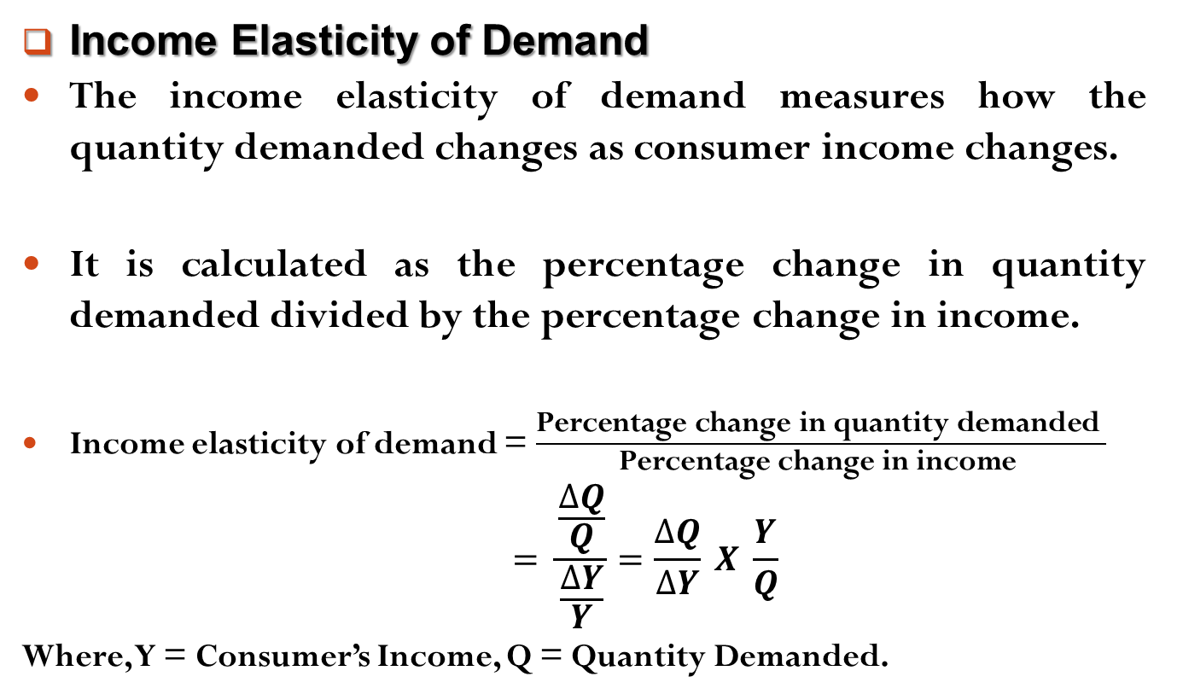
Elasticity of Demand and Supply
Income Elasticity of Demand
The income elasticity of demand measures how the quantity demanded changes as consumer income changes.
It is calculated as the percentage change in quantity demanded divided by the percentage change in income.
Income elasticity of demand = $\frac{\text{Percentage} \text{change} \text{in} \text{quantity} \text{demanded} }{\text{Percentage} \text{change} \text{in} \text{income} }$
$$= \frac{\frac{∆Q}{Q}}{\frac{∆Y}{Y}}=\frac{∆Q}{∆Y} X \frac{Y}{Q}$$
Where, Y = Consumer’s Income, Q = Quantity Demanded.

Slide 4
Elasticity of Demand and Supply
Income Elasticity of Demand
In case of a normal goods, higher income raises the quantity demanded. As quantity demanded and income move in the same direction, normal goods have positive income elasticities.
In case of an inferior goods, higher income lowers the quantity demanded. As quantity demanded and income move in opposite directions, inferior goods have negative income elasticities.

Slide 5
Elasticity of Demand and Supply
Income Elasticity of Demand
Example,
Calculate the income elasticity of demand and interpret the nature of the commodity.
Calculate the income elasticity of demand and interpret the nature of the commodity.
Income [Y] | Quantity Demanded [Q]
70000 | 50
50000 | 70
Income [Y] | Quantity Demanded [Q]
10000 | 75
15000 | 100

Slide 6
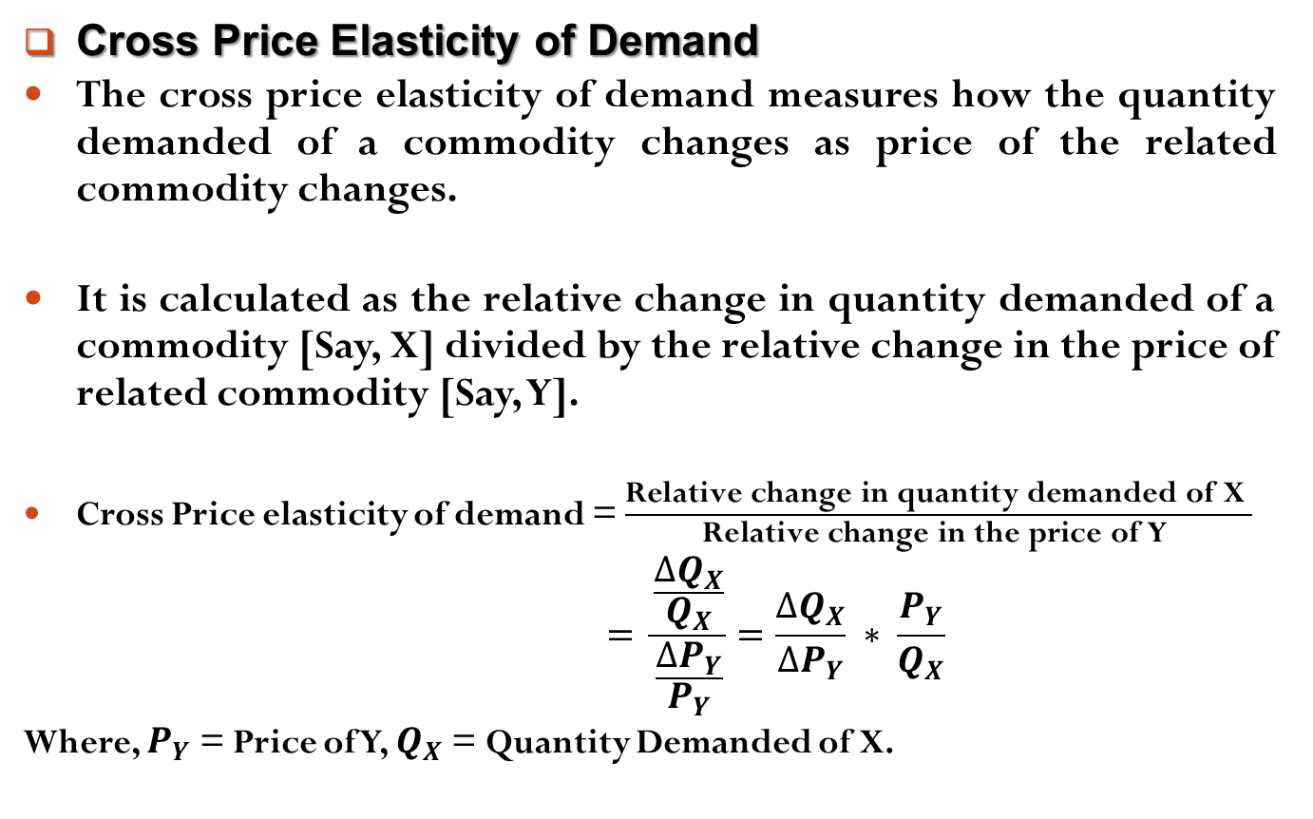
Elasticity of Demand and Supply
Cross Price Elasticity of Demand
The cross price elasticity of demand measures how the quantity demanded of a commodity changes as price of the related commodity changes.
It is calculated as the relative change in quantity demanded of a commodity [Say, X] divided by the relative change in the price of related commodity [Say, Y].
Cross Price elasticity of demand = $\frac{\text{Relative} \text{change} \text{in} \text{quantity} \text{demanded} \text{of} \text{X} }{\text{Relative} \text{change} \text{in} \text{the} \text{price} \text{of} \text{Y} }$
$$= \frac{\frac{∆Q_{X}}{Q_{X}}}{\frac{∆P_{Y}}{P_{Y}}}=\frac{∆Q_{X}}{∆P_{Y}} ∗ \frac{P_{Y}}{Q_{X}}$$
Where, $P_{Y}$ = Price of Y, $Q_{X}$ = Quantity Demanded of X.

Slide 7
Elasticity of Demand and Supply
Cross Price Elasticity of Demand
In case of substitutes goods, higher prices of a commodity raises the quantity demanded of its related commodity. As quantity demanded of one good and price of substitute move in the same direction, substitute goods have positive cross price elasticities.
In case of complementary goods, higher prices of a commodity falls the quantity demanded of its related commodity. As quantity demanded of one good and price of complementary good move in the opposite direction, complementary goods have negative cross price elasticities.

Slide 8
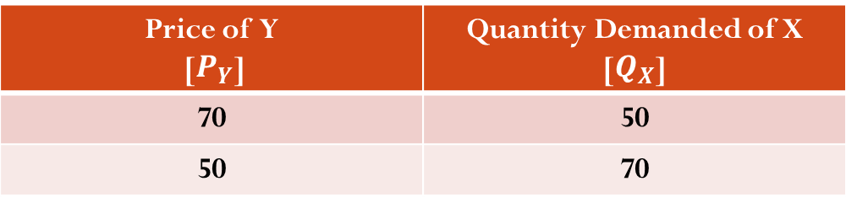
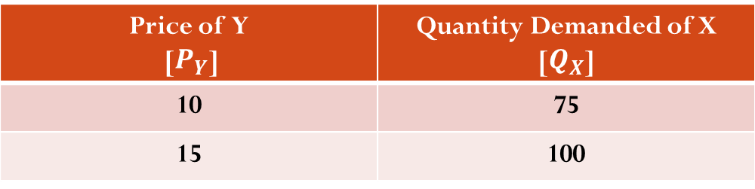
Elasticity of Demand and Supply
Cross Price Elasticity of Demand
Calculate the cross price elasticity of demand and interpret the nature of the commodity.
Calculate the income elasticity of demand and interpret the nature of the commodity.
Price of Y [$P_{Y}$] | Quantity Demanded of X [$Q_{X}$]
70 | 50
50 | 70
Price of Y [$P_{Y}$] | Quantity Demanded of X [$Q_{X}$]
10 | 75
15 | 100

Slide 9
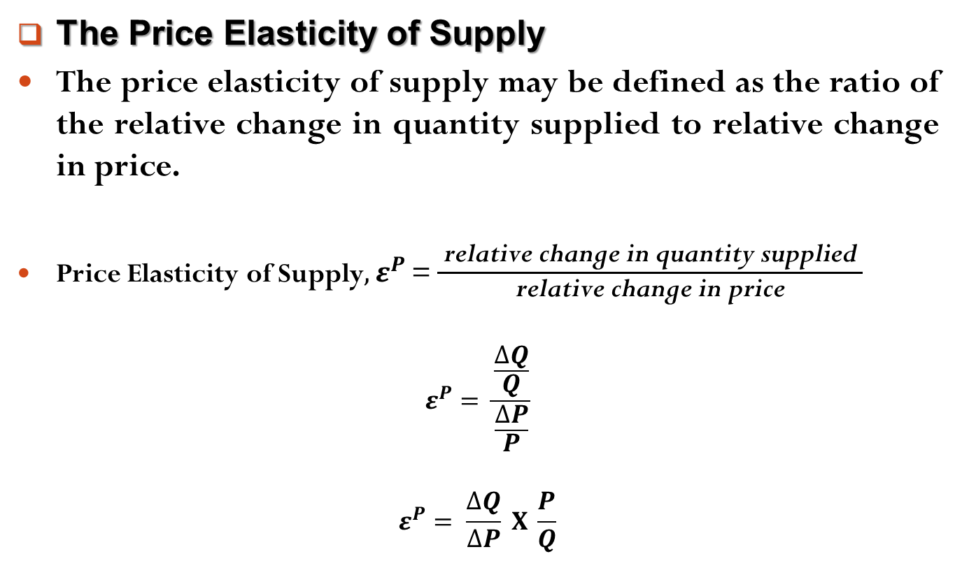
Elasticity of Demand and Supply
The Price Elasticity of Supply
The price elasticity of supply may be defined as the ratio of the relative change in quantity supplied to relative change in price.
Price Elasticity of Supply${, ε}^{P}$ = $\frac{ \text{relative} \text{change} \text{in} \text{quantity} \text{supplied} }{\text{relative} \text{change} \text{in} \text{price}}$
$$ε^{P}= \frac{\frac{∆Q}{Q}}{\frac{∆P}{P}}$$
$$ε^{P}= \frac{∆Q}{∆P} X \frac{P}{Q}$$

Slide 10
Elasticity of Demand and Supply
The Price Elasticity of Supply
There are five types of price elasticity of supply. They are,
Relatively Elastic Supply
Relatively Inelastic Supply
Unitary Elastic Supply
Perfectly Elastic Supply
Perfectly Inelastic Supply

Slide 11
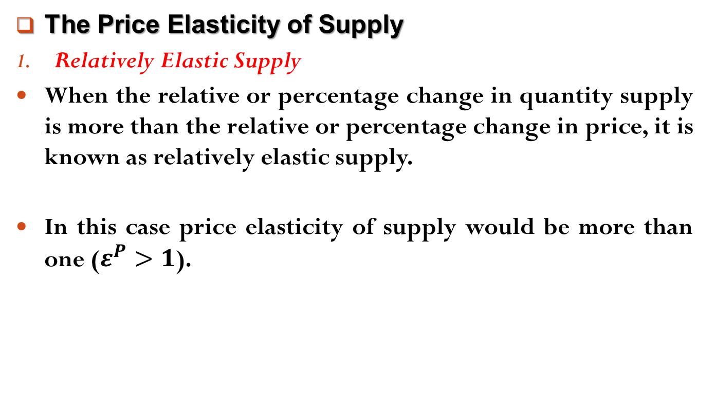
Elasticity of Demand and Supply
The Price Elasticity of Supply
Relatively Elastic Supply
When the relative or percentage change in quantity supply is more than the relative or percentage change in price, it is known as relatively elastic supply.
In this case price elasticity of supply would be more than one ($ε^{P}>1$).

Slide 12
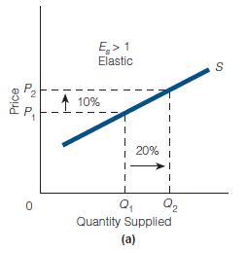
Elasticity of Demand and Supply
The Price Elasticity of Supply
Relatively Elastic Supply

Slide 13
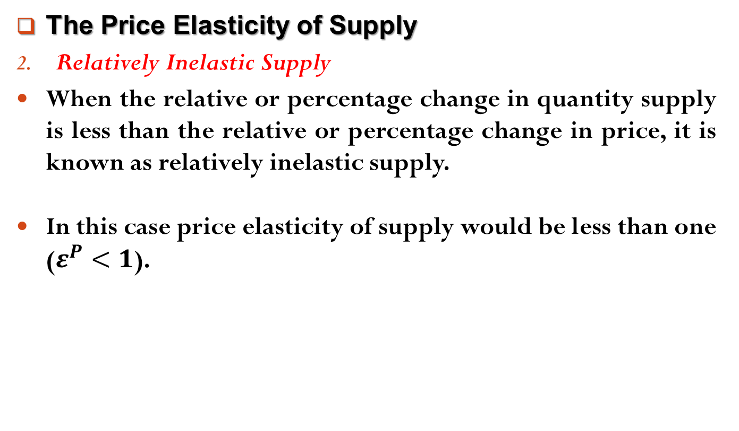
Elasticity of Demand and Supply
The Price Elasticity of Supply
Relatively Inelastic Supply
When the relative or percentage change in quantity supply is less than the relative or percentage change in price, it is known as relatively inelastic supply.
In this case price elasticity of supply would be less than one ($ε^{P}<1$).

Slide 14
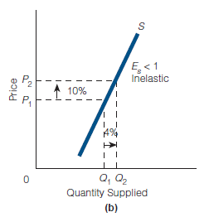
Elasticity of Demand and Supply
The Price Elasticity of Supply
Relatively Inelastic Supply

Slide 15
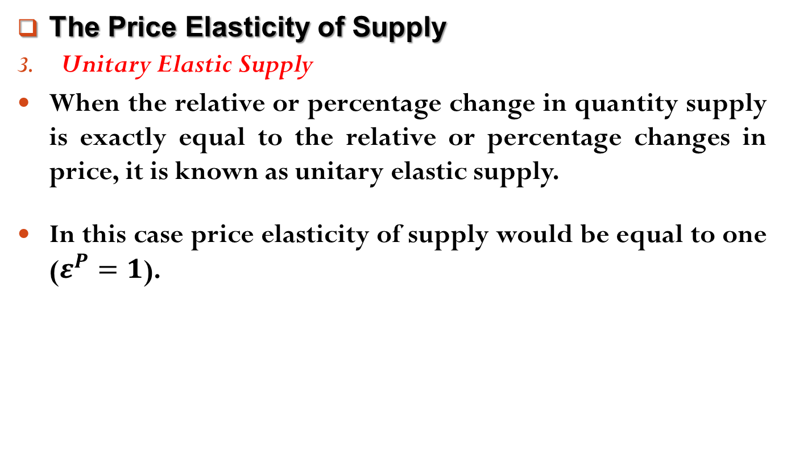
Elasticity of Demand and Supply
The Price Elasticity of Supply
Unitary Elastic Supply
When the relative or percentage change in quantity supply is exactly equal to the relative or percentage changes in price, it is known as unitary elastic supply.
In this case price elasticity of supply would be equal to one ($ε^{P}=1$).

Slide 16
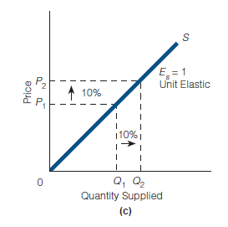
Elasticity of Demand and Supply
The Price Elasticity of Supply
Unitary Elastic Supply

Slide 17
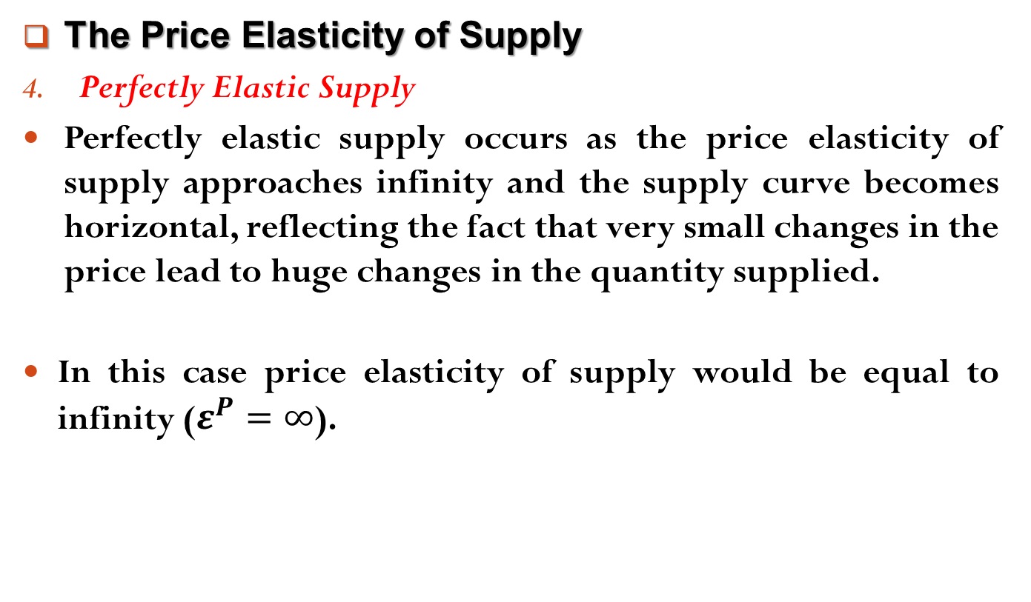
Elasticity of Demand and Supply
The Price Elasticity of Supply
Perfectly Elastic Supply
Perfectly elastic supply occurs as the price elasticity of supply approaches infinity and the supply curve becomes horizontal, reflecting the fact that very small changes in the price lead to huge changes in the quantity supplied.
In this case price elasticity of supply would be equal to infinity ($ε^{P}=∞$).

Slide 18
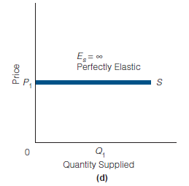
Elasticity of Demand and Supply
The Price Elasticity of Supply
Perfectly Elastic Supply

Slide 19
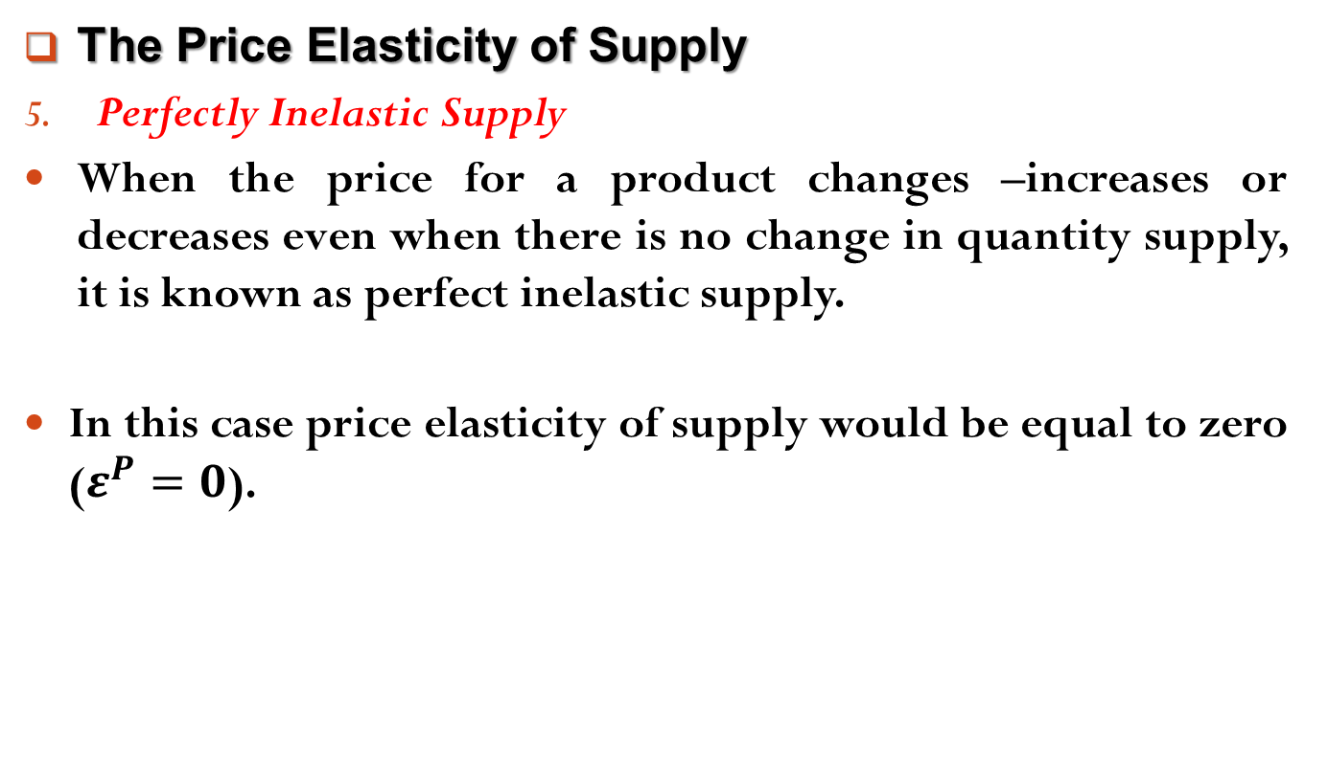
Elasticity of Demand and Supply
The Price Elasticity of Supply
Perfectly Inelastic Supply
When the price for a product changes –increases or decreases even when there is no change in quantity supply, it is known as perfect inelastic supply.
In this case price elasticity of supply would be equal to zero ($ε^{P}=0$).

Slide 20
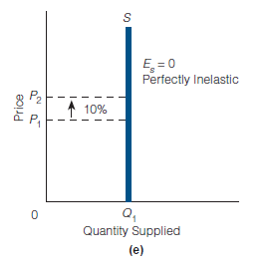
Elasticity of Demand and Supply
The Price Elasticity of Supply
Perfectly Inelastic Supply

Slide 21
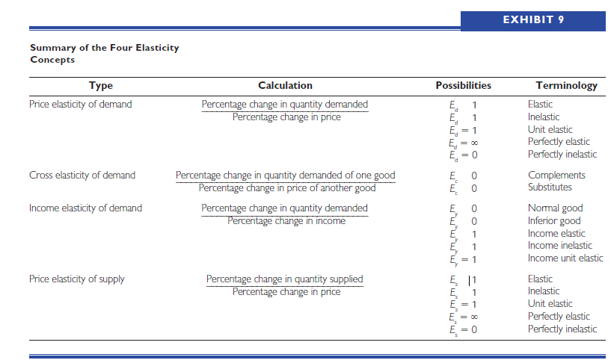
Elasticity of Demand and Supply
Summary of the Four Elasticity Concepts

Slide 22
Readings
N. G. Mankiw- Principles of Microeconomics, 5th Edition, Chapter – 5.
Roger A. Arnold- Microeconomics, 10th Edition, Chapter – 6.

Slide 23


Slide 24
Thank You

